Slide 1
Flight Delay Analysis
Rangaswamyreddy Kappeta
Ranadeep Reddy Gurram

Slide 2
Introduction:
People use flights mostly because it is the fastest and most convenient mode of transportation for long distances.
Flights can cover vast distances in a matter of hours, which would take days or even weeks by car or train. Additionally, flights offer a level of comfort and luxury that is not available on other modes of transportation.
Modern airplanes are equipped with amenities such as entertainment systems, comfortable seating, and in-flight meals, making air travel a more enjoyable experience.

Slide 3
Implementation:
We have collected data on flights from the link https://dataverse.harvard.edu/dataset.xhtml?persistentId=doi:10.7910/DVN/HG7NV7
The data which I took has 30 columns and 25 million rows.
The data is loaded in to pyspark for Exploratory Data Analysis and Preprocessing steps.
Logistic Regression Algorithm is built to predict the Delay of flights
The cleaned data is loaded to MongoDB and connected to Tableau for visualizations and observing trends.

Slide 4
Steps Changed from the Defense Proposal:
In Defense Proposal we have stated that the raw data will be loaded to MongoDB and then EDA ,preprocessing will be carried out but As stated in the progress report we have exported the cleaned data to MongoDB.

Slide 5
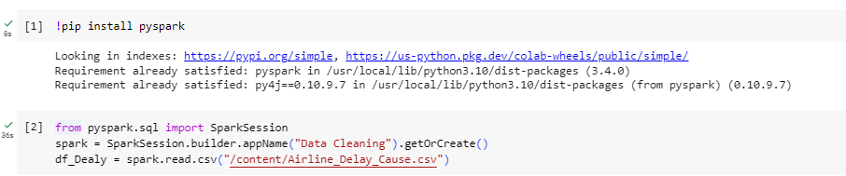
Project Procedure:
The Data is loaded using pyspark by creating spark session and reading the files from the years 2005-2008.

Slide 6
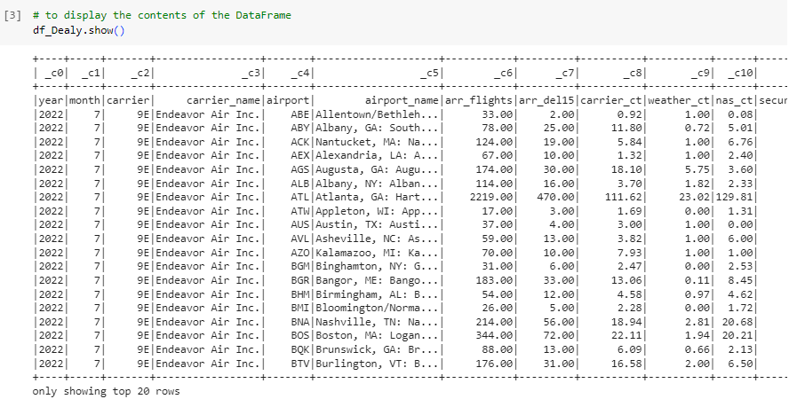
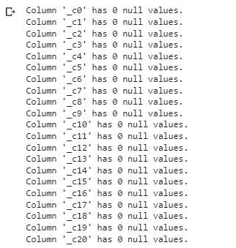
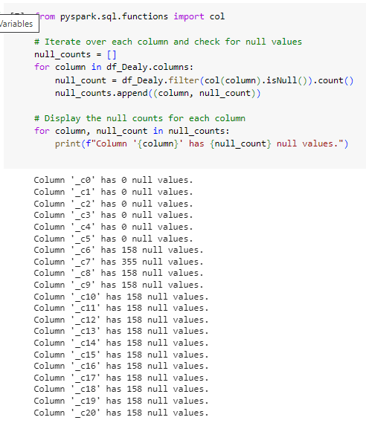
Then Data Cleaning and EDA is done ,the following snippets shows the entire process:

Slide 7
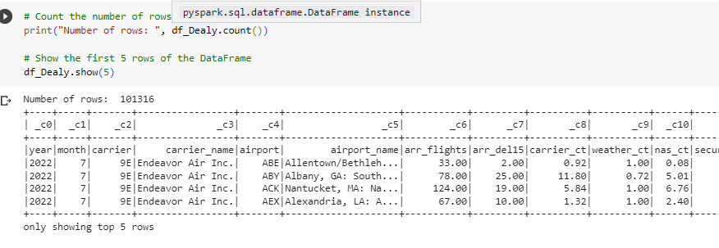
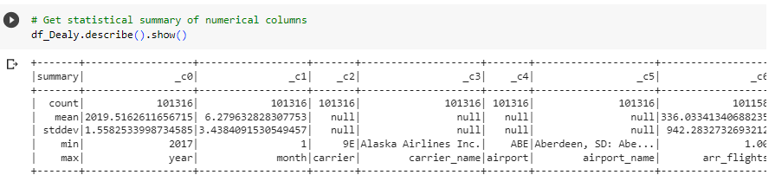
Performing few operations on columns:

Slide 8
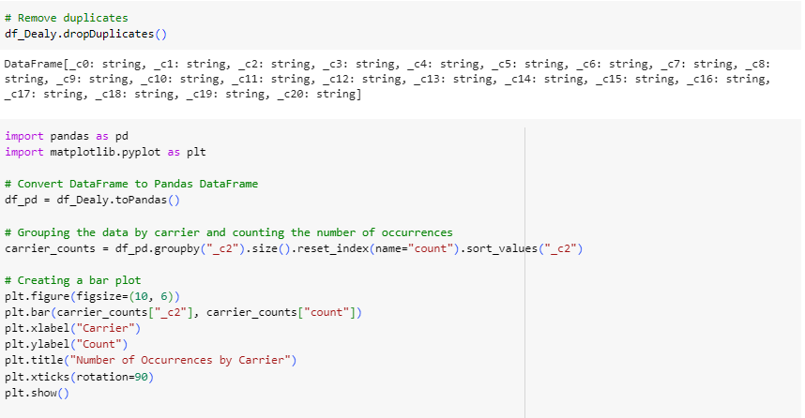
The code snippet and output of Plotting the Number of flights by each carrier in a year

Slide 9
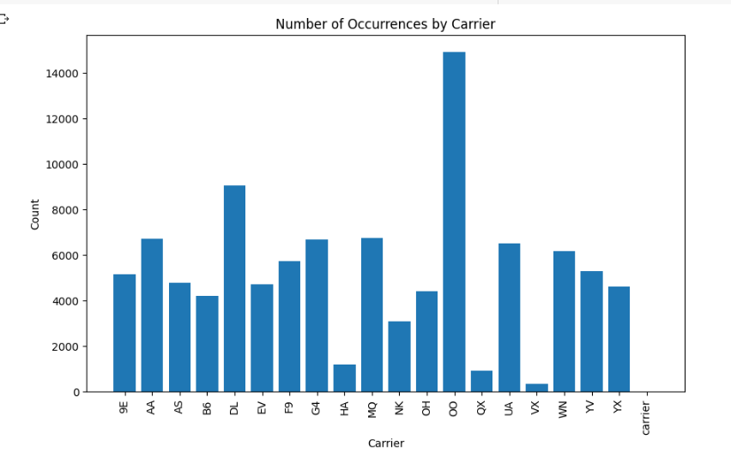
The graph:

Slide 10
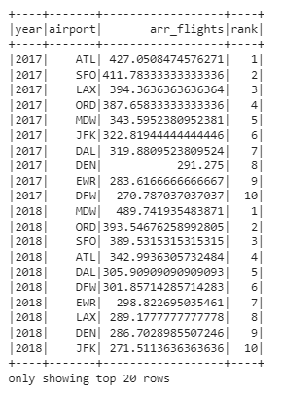
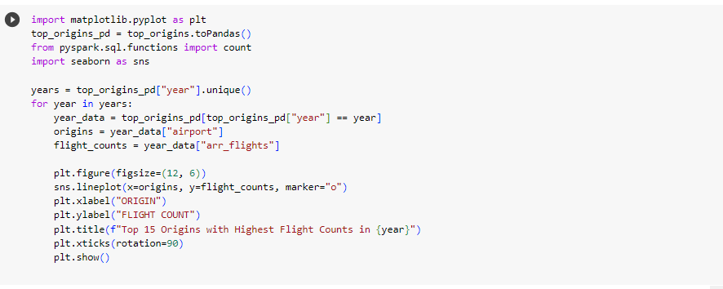
Top 10 origin airports with highest average delay year wise:

Slide 11
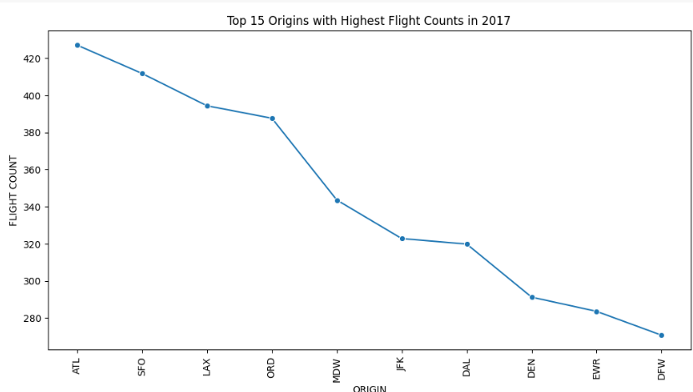
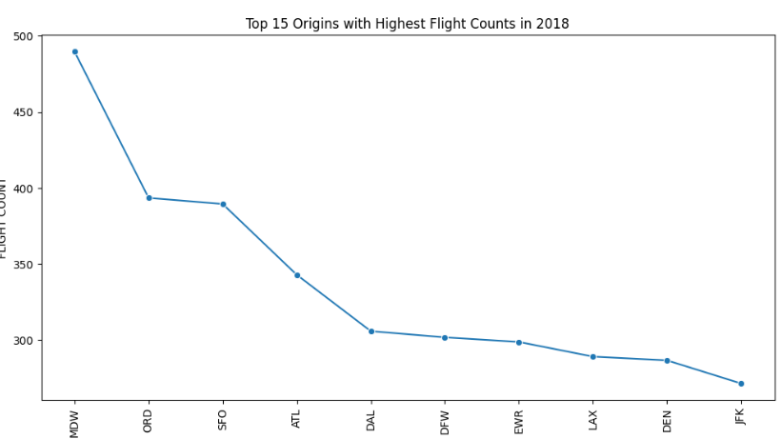
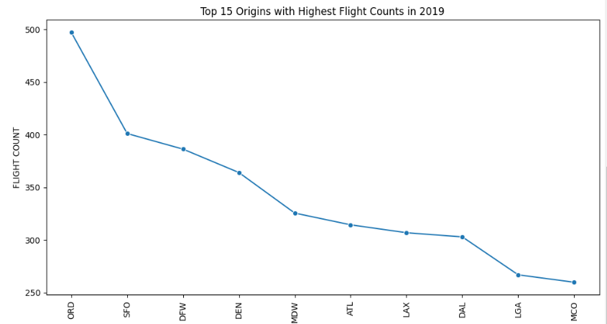
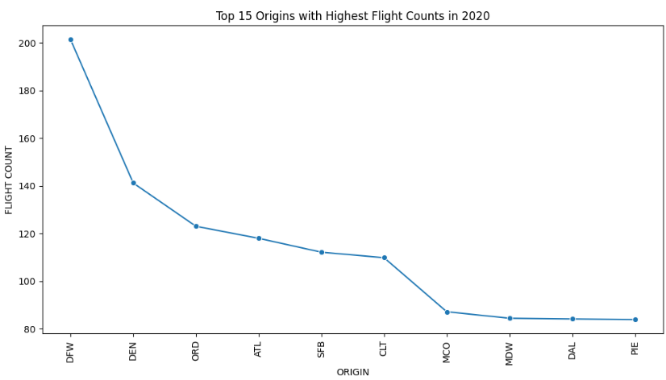
Top 15 Highest Flight Counts for each year:

Slide 12
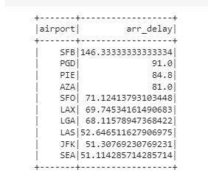
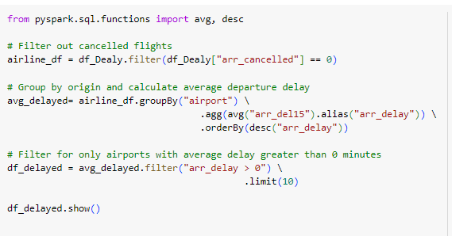
Busiest Airport and Highest Average Delay on Departures:

Slide 13
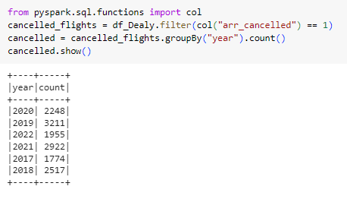
Total Cancellations:

Slide 14
Conclusion:
Atlanta International Airport has highest flight counts,It is the busiest airport
Highest Average delay is happened at OGD(Ogden-Hinckley Airport)
The Total Cancellations in each year is:
2020| 2248|
2019| 3211|
2022| 1955|
2021| 2922|
2017| 1774|
|2018| 2517We built the model of logistic regression and got accuracy of 78 percent.
From visualizations:
The highest delays are possible on Thursday and lowest are on Friday.
On Monday there is least delay of flights.
There is least delay happened on 9th date of every month.
The highest delay happened on 22nd of every month .
Lowest delay happened on August.
Most delay happened on October month

Slide 15
Future Scope:
The project can be done more time efficiently if we have more resources such as AWS S2 engine.
Live data can be inputted with same feature columns.
The model can be saved using pickle and used for further future predictions.
An area for future consideration in this project could be to explore the use of more advanced machine learning models to predict flight delays with higher accuracy. This could involve incorporating additional features into the model, such as weather conditions, aircraft maintenance schedules, and airport congestion levels.
Another potential future consideration is to collaborate with airlines and airports to provide them with real-time insights into flight delays and cancellations. This could involve creating customized dashboards or reports to meet their specific needs and requirements, enabling them to take proactive measures to minimize disruptions and improve their overall operations.

Slide 16
References:
https://www.kaggle.com/code/rashid60/ml-with-pyspark-predicting-flight-delays/notebook
https://towardsdatascience.com/first-time-machine-learning-model-with-pyspark-3684cf406f54
https://www.tableau.com
https://dataverse.harvard.edu/dataset.xhtml?persistentId=doi:10.7910/DVN/HG7NV7
https://campus.datacamp.com/courses/big-data-fundamentals-with-pyspark/pyspark-sql-dataframes?ex=11

Slide 17
Thank you

